Slide 1
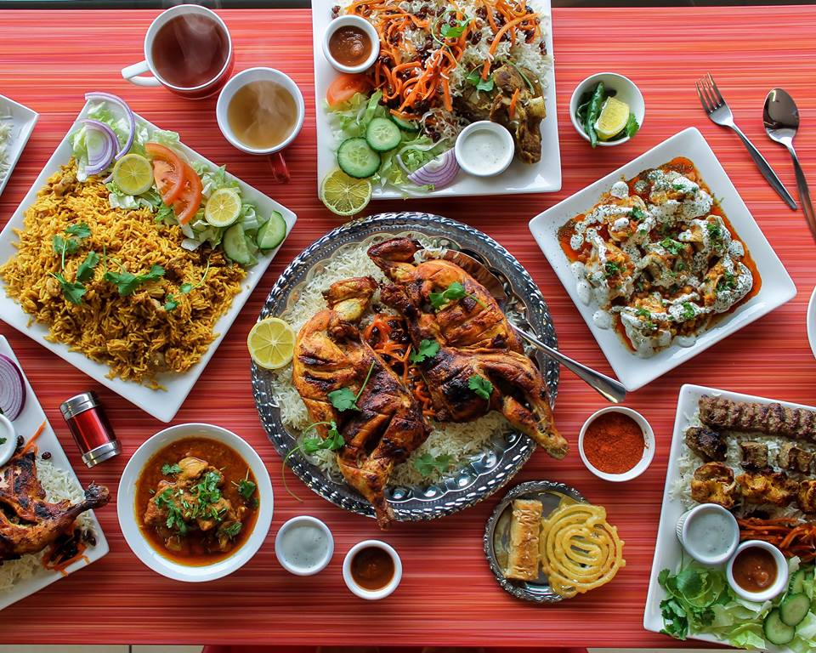
An Afghan restaurant in toronto

Slide 2
Immigrant groups tend to foster businesses expressing their cultural heritage
There are approx. 20,000 Afghan-Canadians in the Toronto area
There is only one Afghan restaurant in Toronto to serve their culinary needs
Supporting these communities helps bridge cultural divides
It is important to support capital investments into small businesses, especially those for vulnerable populations such as minority groups and immigrants

Slide 3
Data acquisition and cleaning
Venue data for neighborhoods retrieved from Foursquare API
Postal code and location data web-scraped from Wikipedia
Demographic and economic information collected from Toronto Open Data Portal
Null, irrelevant, or duplicated features were dropped
Cleaned data contained neighborhoods, location data (Lat/long), 10 decile income information, and values on the number of Afghans living in each neighborhood

Slide 4
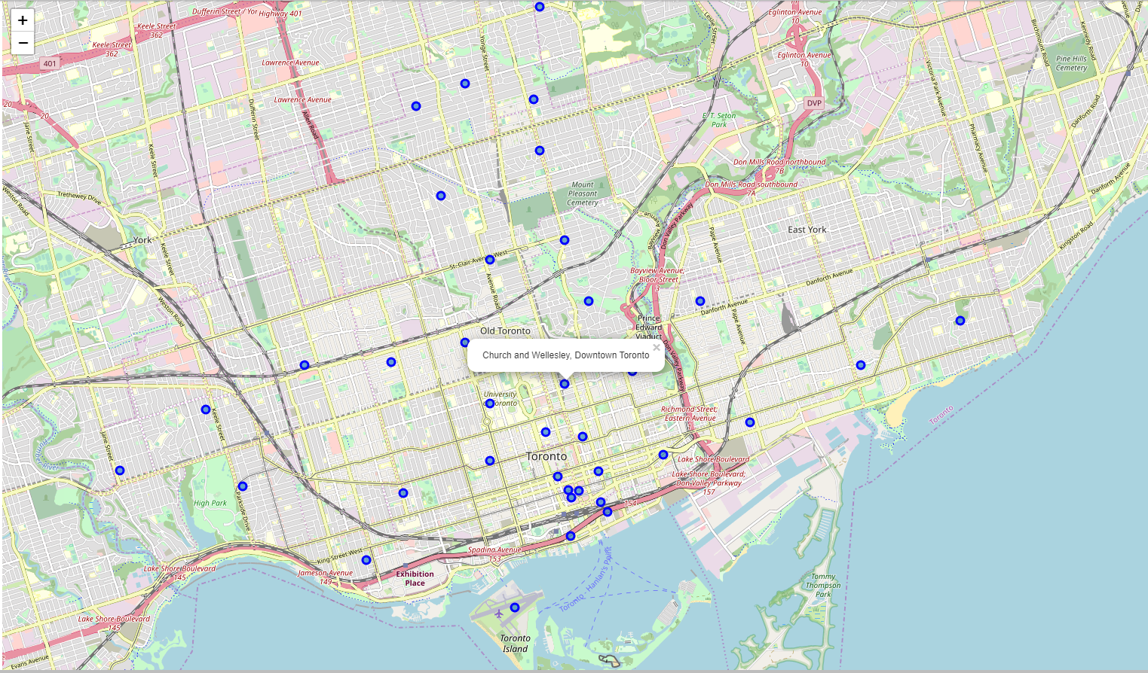
Current restaurant locations
Church and Wellesley in Downtown Toronto has the only Afghan restaurant based on Foursquare Data joined with the location data

Slide 5
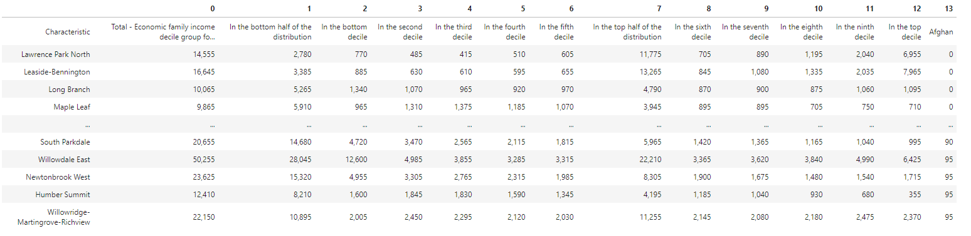
Potential locations
4 neighborhoods tied for the most number of Afghan-Canadians at 95 persons
Only the Willowridge-Martingrove-Richview neighborhood had more persons in the top 5 income deciles than the bottom, making it the wealthiest neighborhood with a high Afghan population

Slide 6
Conclusion and recommendation
Based on the data, Willowridge-Martingrove-Richview had the highest number of Afghans as well as the most wealth, making it the neighborhood most suited for an Afghan restaurant
However, due to the low population in general of Afghan Canadians, as well as the even distribution among income categories (almost 50-50 split), I would not recommend investment to open an Afghan restaurant in Toronto at this time

